Slide 1
EASY VISA PROJECT
COURSE TITLE: ENSEMBLE TECHNIQUES
DATE: JUNE 22ND, 2022

Slide 2
Contents
Executive summary
Business Problem Overview & solution approach
Exploratory Data Analysis (EDA)
Data preprocessing
Model performance summary
Appendix
Business Insights and Recommendations

Slide 3
BUSINESS PROBLEM OVERVIEW & SOLUTION APPROACH
There is a high demand for human resources in the business communities on the united states
Companies are seeking out abroad for hardworking, talented and qualified individuals to fill the position
There are agencies in the united states like The immigration and Nationality Act (INA), who gives the permit for foreign workers on either temporary or permanent basis, and also protect US workers against adverse impact on their wages or working conditions
Secondly, The Office of Foreign Labor Certifications (OFLC) processes and grant job certification applications for employers , where they can demonstrate that there are not sufficient US workers available to perform the work at wages that meet or exceed the wage paid for the occupation in the area of intended employment.
The process of reviewing every application is becoming a tedious task as the number of applicants is increasing every year, with a nine percent increase from the previous year
To analyze the data with the help of classification model
To facilitate the process of visa approvals and recommend a fitting profile for the applicants for whom the visa should be certified or denied based on the drivers that significantly influence the case status.

Slide 4
DATA OVERVIEW
The data set consist of 25,480 rows and 12 columns
we have nine (9) object type, which means they have text values and 1 float and 2 integer
there are no missing or duplicated value in the dataset
The average prevailing wage paid to employees in similar role is 74,456
the maximum number of number of employees 602,069
The average year of the company establishment was in 1979

Slide 5
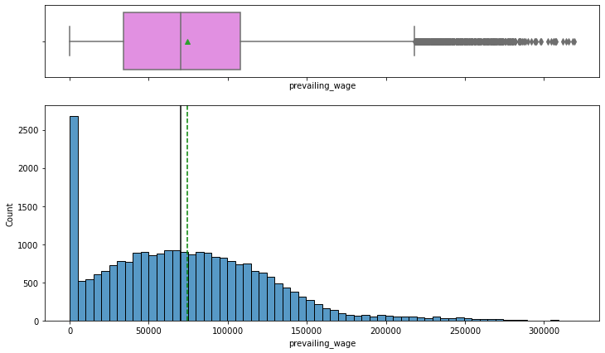
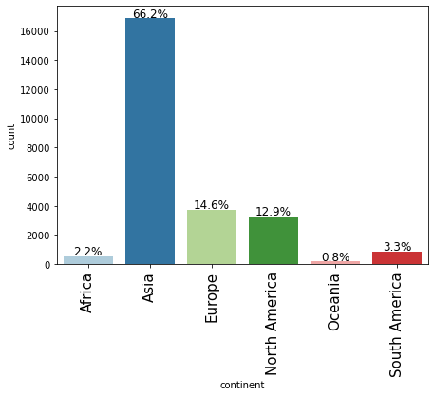
EXPLORATORY DATA ANALYSIS(EDA)
The distribution for prevailing wage is rightly skewed
The boxplot shows that there are a lot outliers to the right for this variable.
176 applicants had less than 100 as their prevailing wage
Asia had the highest number of applicants at 66.2%
We have Europe and north America coming in 2nd and 3rd respectively, followed by south America, Africa and Oceania at 0.8%

Slide 6
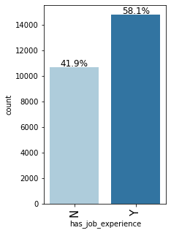
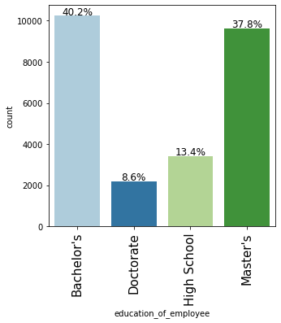
EXPLORATORY DATA ANALYSIS(EDA)
The chart shows the highest of 40.2% applicants has bachelor’s ,
37.8% has master’s, 13.4% has just high school certificate
And 8.6% has a doctorate degree
More than half (58.1%) of the applicants has job experience
41.9% has no job experience

Slide 7
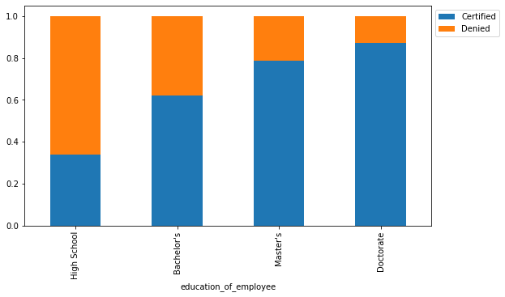
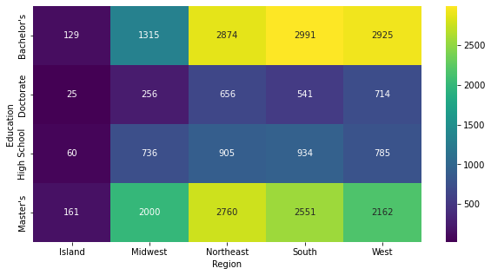
EXPLORATORY DATA ANALYSIS(EDA)
The distribution below shows that the level of education has an impact on visa certification
Candidates with just high school certificate has a very low rate on visa acceptance
The higher the education of the employee the higher the chance with doctorate degree having the highest rate of visa approval
The heat map chart shows that different regions have different requirement on educational background
The island takes the lowest number of applicants which can be due to size of population

Slide 8
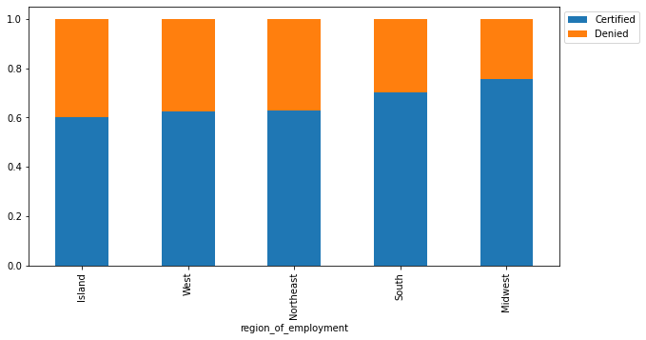
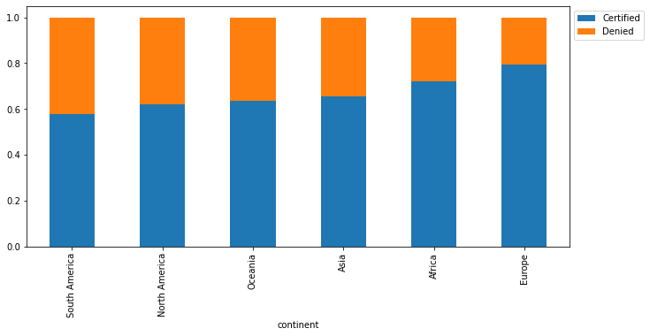
EXPLORATORY DATA ANALYSIS(EDA)
The island has the highest denial rate across all regions with approximately 40%
The west and northeast has 38% and 37% denial rate
The Midwest has the lowest denial rate of 25%
Across the continent, Europe and Africa has the highest approval rate of visa with 79% and 72% respectively
Asia, Oceania & North America has 65%, 64% & 62% approval rate respectively
South America has the lowest approval rate with 58%

Slide 9
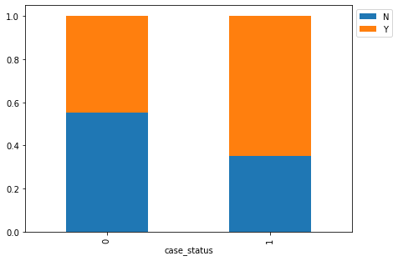
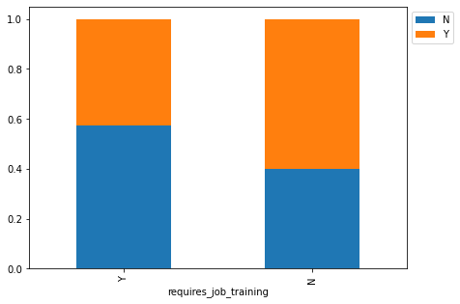
EXPLORATORY DATA ANALYSIS(EDA)
26% of applicants were denied visa application even with their job experience
44% of applicants who have no job experience were denied visa
This distribution shows having job experience has an effect on visa certification
Yes, very few applicants who have work experience required job training
This distribution shows that just 9% requires job training even with job experience

Slide 10
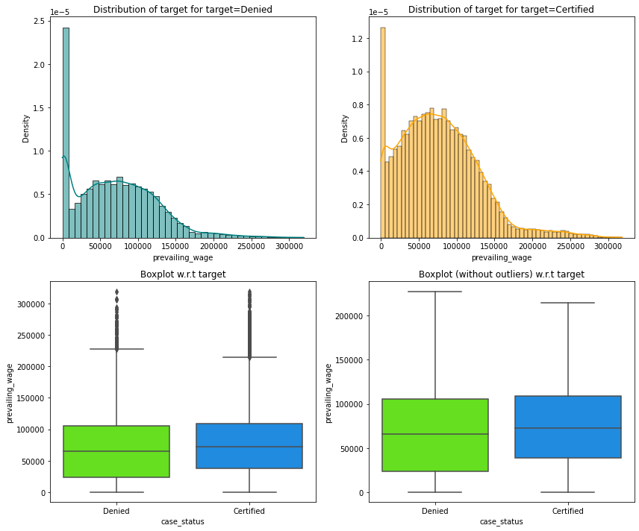
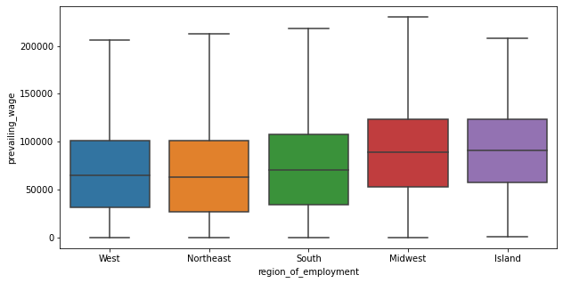
EXPLORATORY DATA ANALYSIS(EDA)
There are outliers in the boxplots of both distribution
The distribution shows the case status changes slightly with prevailing wages
This distribution shows prevailing wage is slightly similar across all regions

Slide 11
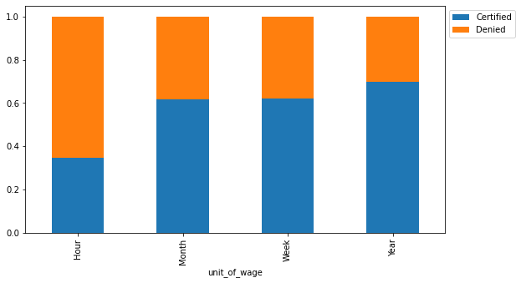
EXPLORATORY DATA ANALYSIS(EDA)
The different units has an impact on visa been certified, with hourly unit having the lowest certified rate
The yearly unit has the highest certified rate, along with the monthly and weekly

Slide 12
DATA PREPROCESSING
There are no duplicates or missing value in the data set
Outliers was found in the box plot for prevailing wage and year of establishment
The data preparation will be used to predict which visa will be certified

Slide 13
MODEL PERFORMANCE SUMMARY
Build a predictive model that can predict which visa will be certified
F1 score will be used as performance metric of evaluation
if a visa is certified when it had to be denied a wrong employee will get the job position while US citizens will miss the opportunity to work on that position.
If a visa is denied when it had to be certified the U.S. will lose a suitable human resource that can contribute to the economy.
The greater the F1 score higher are the chances of minimizing False Negatives and False
The most significant predictors of get a visa certified
Education of employee
Job experience
Prevailing wage

Slide 14
MODEL PERFORMANCE SUMMARY
Model | Train accuracy | Test Accuracy | Train recall | Test recall | Train precision | Test precision | Train F1 | Test F1
Decision Tree | 1.0 | 0.64 | 1.0 | 0.72 | 1.0 | 0.74 | 1.0 | 0.73
Tuned Decision Tree | 0.71 | 0.70 | 0.93 | 0.93 | 0.72 | 0.71 | 0.81 | 0.80
Bagging Classifier | 0.98 | 0.68 | 0.98 | 0.75 | 0.99 | 0.76 | 0.99 | 0.75
Tuned Bagging Classifier | 0.98 | 0.72 | 0.99 | 0.88 | 0.97 | 0.74 | 0.98 | 0.81
Random Forest | 1.0 | 0.70 | 1.0 | 0.80 | 1.0 | 0.76 | 1.0 | 0.78
Tuned Random Forest | 0.77 | 0.74 | 0.89 | 0.87 | 0.79 | 0.77 | 0.84 | 0.81

Slide 15
Adaboost Classifier | 0.73 | 0.73 | 0.89 | 0.88 | 0.75 | 0.75 | 0.82 | 0.81
Tuned Adaboost Classifier | 0.71 | 0.71 | 0.78 | 0.78 | 0.79 | 0.79 | 0.78 | 0.78
Gradient Boost Classifier | 0.75 | 0.74 | 0.88 | 0.87 | 0.78 | 0.77 | 0.83 | 0.82
Tuned Gradient Boost Classifier | 0.76 | 0.74 | 0.88 | 0.87 | 0.78 | 0.77 | 0.83 | 0.81
XGBoost Classifier | 0.82 | 0.73 | 0.92 | 0.85 | 0.83 | 0.76 | 0.87 | 0.80
XGBoost Classifier Tuned | 0.76 | 0.74 | 0.88 | 0.87 | 0.79 | 0.77 | 0.83 | 0.82
Stacking Classifier | 0.77 | 0.74 | 0.88 | 0.86 | 0.79 | 0.77 | 0.83 | 0.81

Slide 16
MODEL BUILDING
DECISION TREE
Model building steps
Model performance
The decision tree is overfitting the training data
Model improvement after hyper parameter tuning
The recall is still overfitting, the decision and f1 test score improved after hyper parameter tuning
BAGGING CLASSIFIER
Model building steps
Model performance:
the bagging classifier is overfitting the training data
The test f1 score decrease from initial model
Model improvement
The training data is still overfitting after hyperparameter tuning, although there is an increase in test f1 score

Slide 17
MODEL BUILDING
RANDOM FOREST
Model building steps
Model performance
The random forest is overfitting the training data
Model improvement
There is an overall improvement on the random forest after hyper parameter tuning
ADABOOST
Model building steps
Model performance
The adaboost model shows no improvement from the initial model and precision decrease
Model improvement
There was a decrease in both recall and f1 test score after hyper parameter tuning

Slide 18
MODEL BUILDING
GRADIENT BOOST
Model building steps
Model performance
The gradient boost shows the highest f1 test score and a balance across all ranges which gives the best model to predict if a visa will be certified
Model improvement
No improvement shown except a decrease in f1 test score after hyper parameter tuning
STACKING CLASSIFIER
Model building steps
Model performance
The stacking classifier shows improvement from all ranges except a decrease in test f1 score from previous model

Slide 19
BUSINESS INSIGHTS AND RECOMMENDATIONS
The following are the insights the data displayed
it shows 66.8% visa were certified and 33.2% were denied
Education of employee (high school), job experience and prevailing wage had a significant influence for whom visa should be certified or denied
The following will be recommended for EASY VISA to help in facilitating the visa process;
Take off high school certification as it has the highest denial rate
Send guest email reminders about the bookings, from the data it shows the average lead time is 85 days, a monthly reminder, 7 days daily reminder to the arrival date
The data also shows guests who have 1 or 2 special requests are more likely to cancel, a higher charge should be implemented when a guest ask for this requests

